Slide 1
A Primer on Information theory & Information Dynamics

Slide 2


Slide 3
What is information?

Slide 4
Colloquial Definitions
“Information – is a difference that makes a difference”
-Gregory Bateson
Notes:
Differences that make a difference Gregory Bateson quote
Dictionary definitions:
Facts learned about something or someone
What is conveyed or represented by a particular arrangement or sequence of things

Slide 5
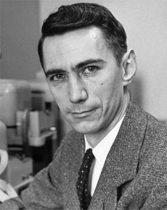
More Technical Definition
“Information is the resolution of uncertainty”
-Claude Shannon

Slide 6
Information Theory
How can information be measured?
How we can ensure the correctness of information?
What to do if information gets corrupted by errors?
How much memory does it require to store information?

Slide 7
Information Theory
Modern information theory was first developed by the great American mathematician, electrical engineer, and computer scientist Claude E. Shannon in his paper “A Mathematical Theory of Communication” published in “The Bell System Technical Journal” in October, 1948.

Slide 8
Quantifying Information Content
What is the information content of any message?
Shannon’s answer: The information content of a message is the number of 1s and 0s it takes to transmit it.

Slide 9
Quantifying Information Content
Hence, the elementary unit of information is a binary unit: a bit, which can in one of two states (i.e., ‘1’ or ‘0’, “True” or “False”, “Yes” or “No”, “Black” or “White”, etc)
One of the basic postulates of information theory is that information can be treated like a measurable physical quantity, such as density or mass.

Slide 10
Shannon Information

Slide 11

A Simple Example: Random Coin Toss
Let’s flip a coin 1 million times and record the sequence of flips.
If you want to communicate this sequence to another person, how many bits will it take?
If it's a fair coin, the two possible outcomes, heads and tails, occur with equal probability.
Therefore each flip requires 1 bit of information to transmit.
To send the entire sequence will require one million bits.

Slide 12

A Simple Example: Biased Coin Toss
Suppose now that the coin is biased so that heads occur only 1/4 of the time, and tails occur 3/4.
The entire sequence can be sent in 811,300 bits, on average. This would seem to imply that each flip of the coin requires just 0.8113 bits to transmit.
Notes:
How can you transmit a coin flip in less than one bit, when the only language available is that of zeros and ones?
You can't. But if the goal is to transmit an entire sequence of flips, and the distribution is biased in some way, then you can use your knowledge of the distribution to select a more efficient code.
Another way to look at it is: a sequence of biased coin flips contains less "information" than a sequence of unbiased flips, so it should take fewer bits to transmit.

Slide 13
Quantifying Information Content
Information Theory regards information as only those symbols that are uncertain to the receiver.
For years, people have sent telegraph messages, leaving out non-essential words such as "a" and "the.”
In the same vein, predictable symbols can be left out, like in the sentence, "only infrmatn esentil to understandn mst b tranmitd”. Shannon made clear that uncertainty is the very commodity of communication.

Slide 14
Probabilities
In this class, we’ll most often assume that the processes we are interested in have a discrete, finite number of outcomes (e.g., Boolean values ‘0’ or ‘1’).
A process can then be represented as a probability distribution over outcomes:

Slide 15
Playing with Probabilities
Given two discrete random variables X and Y we can also define:
Conditional Probability - probability for X to occur given that Y occurred, often denoted as P(X|Y)
Joint Probability – probability for X and Y to both occur, often denoted P(X, Y)
Notes:
Random variable: a measurable function from a probability space into a measureable space known as a state space

Slide 16
Playing with Probabilities
Conditional and joint probability are related:
Example: Tossing two coins
What is the probability of both yielding heads?
if X and Y are independent (reduces to product of marginal probabilities)
Notes:
Note from here you can get directly to Bayes’ Thm.

Slide 17
Entropy Defined
We want a function, call it , that takes a list of probabilities and tells us the “information” in that process.
Let’s require the function to obey four simple axioms:
Continuity
Symmetry
Condition of Maximum Information
Additivity
Adopted from Dedeo “Information for Intelligent People” SFI CCCS Lecture

Slide 18
Continuity
“If I only change the probabilities a little, the information of the process should change only a little”

Slide 19
Symmetry
“If I reorder the list of probabilities I gave you, you should get the same answer”
e.g., if the probabilities are
or
the amount of information I gain on learning the outcome of an event is the same.
Information theory is “syntactic” and does not deal with the meanings of symbols

Slide 20
Condition of Maximum Information
“H(p⃗) is at its maximum value when all the p_{i} are equal”
if every possible outcome (from the list of possible outcomes) is equally likely, the process has the maximum information (our unbiased coin toss example).
Notes:
Note! Do not get confused here. The process itself in this case is very random, and we often associate randomness with lack of information (e.g., if a student starts talking randomly in class, we say he is telling us nothing). But information is concerned with specifying the outcome of a process; imagine having to describe the behavior of a student to a doctor. If the student’s behavior is very random, you have to have a longer conversation (“on Monday he was taking about cats, but then Tuesday he was on to bus schedules, and Wednesday it was about the filling in his teeth...”) as opposed to a less random, and thus lower information, process (“every day, he says hello and that’s it.”)

Slide 21
Additivity
The outcome should not depend on how we measure the information (i.e., how it is divided into parts)

Slide 22
A Quantitative Measure of Information
Suppose we have to select some equipment from a catalog which indicates n distinct models:
The desired amount of information associated with the selection of a particular model must be a function of the probability of choosing :

Slide 23
A Quantitative Measure of Information
If, for simplicity, we assume that each one of these models is selected with an equal probability, then the desired amount of information is only a function of n:

Slide 24
A Quantitative Measure of Information
Let’s now imagine that each piece of equipment can be ordered in one of m different colors and the selection of colors is also equiprobable, then the amount of information associated with the selection of a color is :

Slide 25
A Quantitative Measure of Information
The selection may be done in two ways:
Select the equipment and then the color independently of each other
Select the equipment and its color at the same time as one selection from mn possible choices:

Slide 26
A Quantitative Measure of Information
Since these amounts of information are identical, we obtain:
Among several solutions of this functional equation, the most important for us is:
Notes:
Thus, when a statistical experiment has n equiprobable outcomes, the average amount of information associated with an outcome is log n

Slide 27
A Quantitative Measure of Information
The logarithmic information measure has the desirable property of additivity for independent statistical experiments.
The simplest case to consider is a selection between two eqiuprobable events. The amount of information associated with the selection of one out of two equiprobable events is
and provides a unit of information known as a bit.

Slide 28
Shannon Entropy (finally!)
Note relationship to Gibbs entropy which differs only by a constant (the Boltzmann factor)

Slide 29

Landauer: Information is physical!
Information is not an abstract entity but exists only through a physical representation, thus tying it to all the restrictions and possibilities of our real physical universe.
R. Landauer “The physical nature of information” Phys. Lett. A 1996
Notes:
Can measure it for physical systems

Slide 30
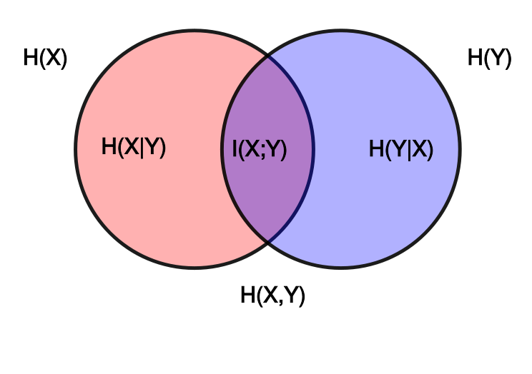
Mutual Information
Mutual information is a measure of the mutual dependence between two variables, or the amount of information you gain by knowing one variable about the other.
Notes:
I(X;Y) = 0 iff X and Y are independent random variables, it is always non-negative, and is symmetric

Slide 31
Useful Information Measures
Mutual information:
Joint Entropy:
Conditional Entropy:
See Lizier et al. “A framework for the local information dynamics of distributed computation in complex systems”

Slide 33
Information Dynamics: Connecting Information theory and the component operations of computation
We talk about computation as:
Memory
Processing/signaling
Modification (memory ⬅➔ processing)
These can be quantified by:
Information storage
Information transfer
Information modification
Notes:
Distributed computation is any process that involves these features!
General idea: by quantifying intrinsic computation in the language it is normally described in, we can understand how nature computes and why it is complex.

Slide 34
Information Storage
The information storage of an agent in the system is the amount of information in its past that is relevant to predicting its future.
In information dynamics, information storage is quantified with the active information

Slide 35
Information Transfer
The information transfer between a source and a destination agent is defined as the information provided by the source about the destination’s next state that was not contained in the past of the destination.
In information dynamics it is quantified by the transfer entropy

Slide 36
Time Series Data
Time Step | a | b | c
1 | 1 | 1 | 1
2 | 0 | 1 | 1
3 | 0 | 1 | 0
4 | 1 | 0 | 0
5 | 0 | 1 | 1
6 | 0 | 1 | 0
7 | 1 | 0 | 0
8 | 0 | 1 | 1
9 | 0 | 1 | 0
10 | 1 | 0 | 0
A sequence of time ordered observations of some system.
For example, the Boolean network generates the set of states of nodes in the order of time.
To measure information dynamics on the time series data, we need to compute the distribution for each pattern to occur in the data.

Slide 37
Calculating Probability Distributions
Time Step | a | b | c
1 | 1 | 1 | 1
2 | 0 | 1 | 1
3 | 0 | 1 | 0
4 | 1 | 0 | 0
5 | 0 | 1 | 1
6 | 0 | 1 | 0
7 | 1 | 0 | 0
8 | 0 | 1 | 1
9 | 0 | 1 | 0
10 | 1 | 0 | 0
: k history state of X
The states of node X from k consecutive previous steps from the current step n
: future state of X
We want to know the state of node X at the next step for the current step n
For example,

Slide 38
Calculating Probability Distributions
Time Step | a | b | c
1 | 1 | 1 | 1
2 | 0 | 1 | 1
3 | 0 | 1 | 0
4 | 1 | 0 | 0
5 | 0 | 1 | 1
6 | 0 | 1 | 0
7 | 1 | 0 | 0
8 | 0 | 1 | 1
9 | 0 | 1 | 0
10 | 1 | 0 | 0
With a given N time series data,
: Joint probability for a certain pair of future state of X and its k history state to occur.
The total number of patterns in the given data is N - k.
For example,
= 2 / 7

Slide 39
Active Information
Time Step | a | b | c
1 | 1 | 1 | 1
2 | 0 | 1 | 1
3 | 0 | 1 | 0
4 | 1 | 0 | 0
5 | 0 | 1 | 1
6 | 0 | 1 | 0
7 | 1 | 0 | 0
8 | 0 | 1 | 1
9 | 0 | 1 | 0
10 | 1 | 0 | 0
Mutual dependence between future state of a variable and history state of the variable for a given time series data.
It is interpreted as information storage
< > means average over all possible patterns.

Slide 40
Transfer Entropy
Time Step | a | b | c
1 | 1 | 1 | 1
2 | 0 | 1 | 1
3 | 0 | 1 | 0
4 | 1 | 0 | 0
5 | 0 | 1 | 1
6 | 0 | 1 | 0
7 | 1 | 0 | 0
8 | 0 | 1 | 1
9 | 0 | 1 | 0
10 | 1 | 0 | 0
Dependence of future state of destination variable on the previous state of source variable when the history state of the destination is known.
It is interpreted as information transfer
< > means average over all possible initial patterns.

Slide 41
Causation & Information
Information transfer ≠ causality
Lizier & Prokopenko. “Differentiating information transfer and causal effect” 2010

Slide 42
Causation & Information
Another example:
Kim, Davies & Walker “New Scaling Relation for Information Transfer in Biological Networks” (2015)

